Slide 1

CIS634 – Object Oriented Software Engineering
Instructor: Weidong Xiong
Topic:-Restaurant Management System
Presented by:
Patel Riyaben
Bhavana Tedlapalli
Sravan kumar Singupuram
Calvin Raj Namburi

Slide 2
Introduction
This is project is mainly about understanding real time objectives of the Object-Oriented Software Engineering.
We have developed a Restaurant Management system.
We have followed Agile Methodology for building this project.

Slide 3
PROJECT REQUIREMENTS
The project will then use architectural design to generate a broad vision for the evolving system. it moves on to system modeling, which involves creating design models to comprehend the limitations and characteristics of the system. Finally, effective user interface design methods are covered.
We have used HTML, CSS, JS for frontend.
For backend management we have used flask framework and MySQL.
Languages used is python.
The ide we used is visual studio code.

Slide 4
Requirements
The web application will have five interfaces.
Each for customer, manager, receptionist, admin and chef. Receptionist can see/edit the status of available/reserved tables.
Customer's interface will consist of a scrollable menu listing available items, calorie chart for the specific item and their price.
When the customer selects some dishes and place the order, it will be stored in "cart". Manager's interface will be such that he is notified of the pending order, and he is able to assign it to one the available queues of chefs who are then able to see the new order in their screens or on a central display in kitchen.
After each item/dish in an order is prepared, the order is marked completed through the manager's interface. Customer's interface has an option for requesting the bill. Bill is printed through the manager's interface.
Admin can change and modify the firebase database like add new menus or staff, add/remove extra chef‚ äôs, managers on the website.

Slide 5
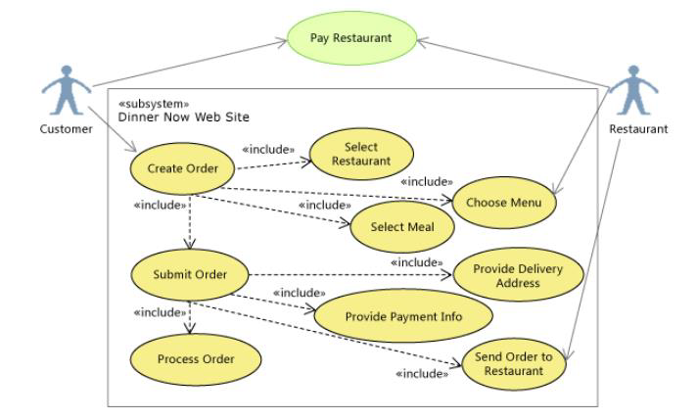
UML USE CASE DESIGN

Slide 6
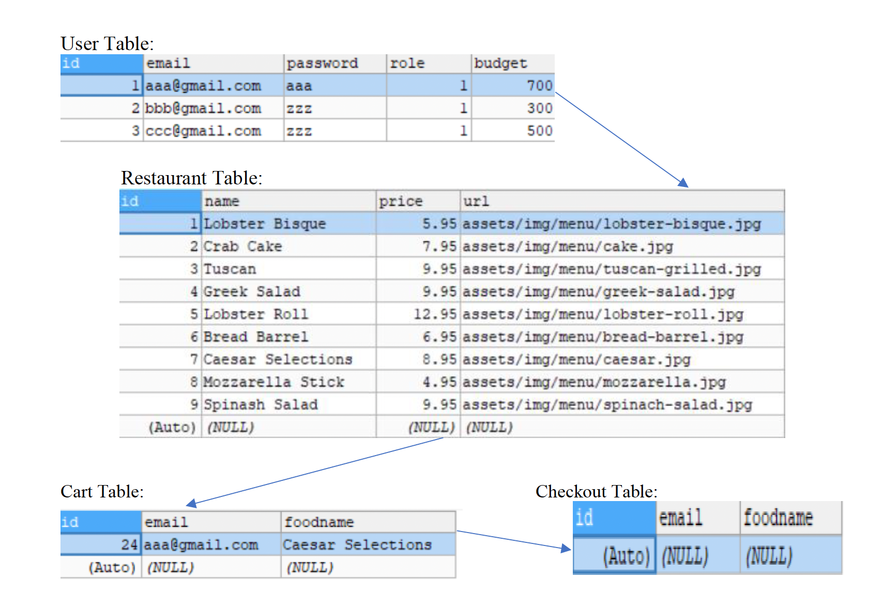
Database Class Diagram

Slide 7


Design
MVC or model view controller architecture was used to develop this system. As a software design pattern for developing web applications MVC is popular.
Mvc architecture divides web application in to three parts. All those parts are interconnected. It is fully capable to support rapid web application development and dynamic interactivity with the database.
Front End:
Visual Studio
GUI Design
Database Modelling
Design Control
BACK End:
Design tables
Design forms

Slide 8
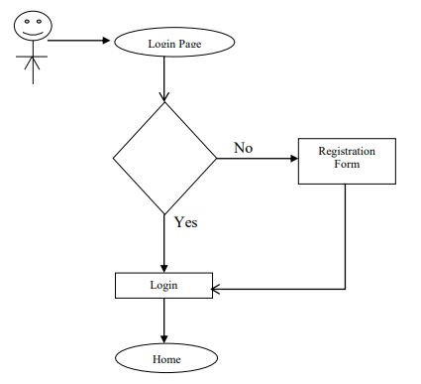
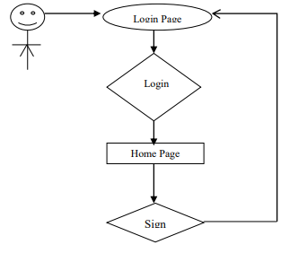
Workflow Process
Fig: Registration WorkFlow Process
Fig: Login WorkFlow Process

Slide 9


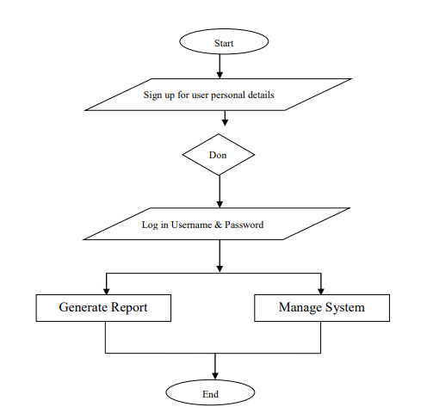
Admin Workflow Process

Slide 10
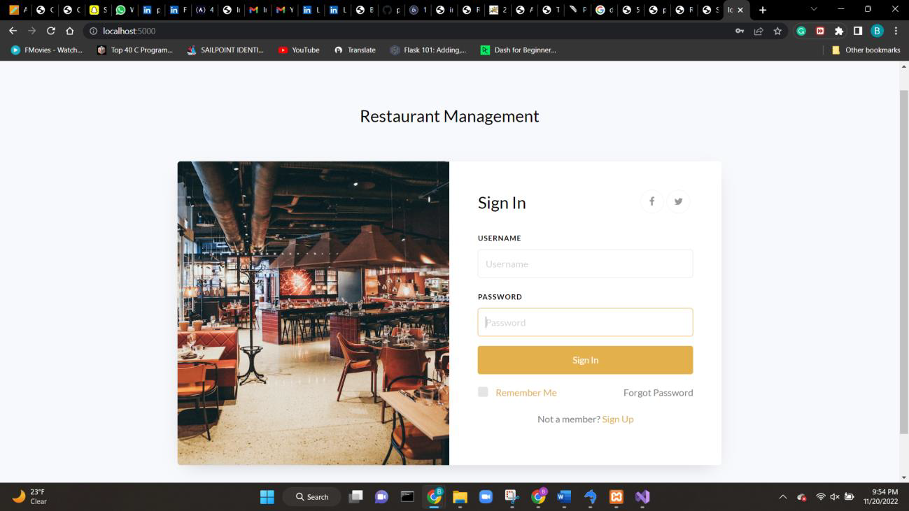
Sign In Page

Slide 11
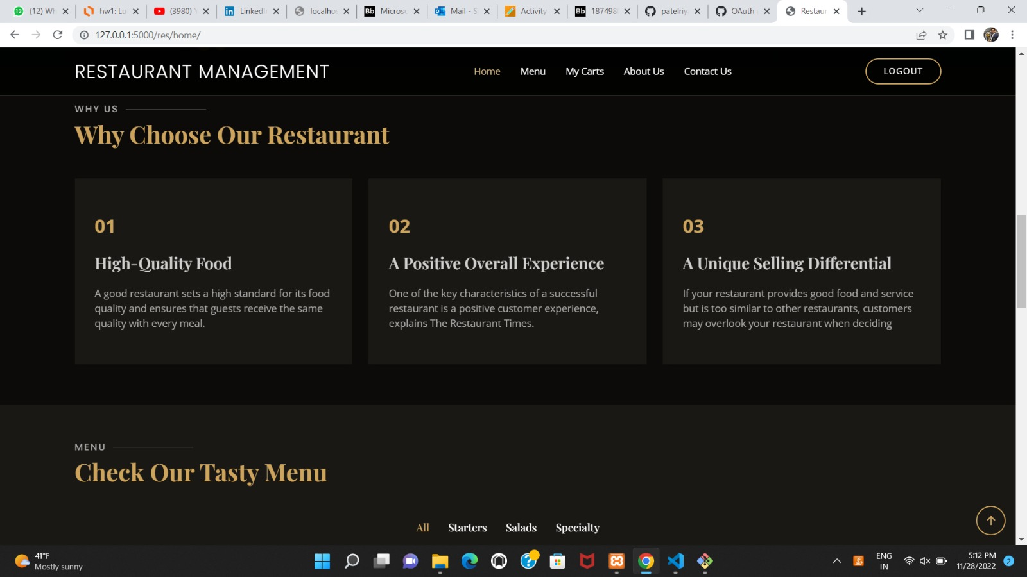
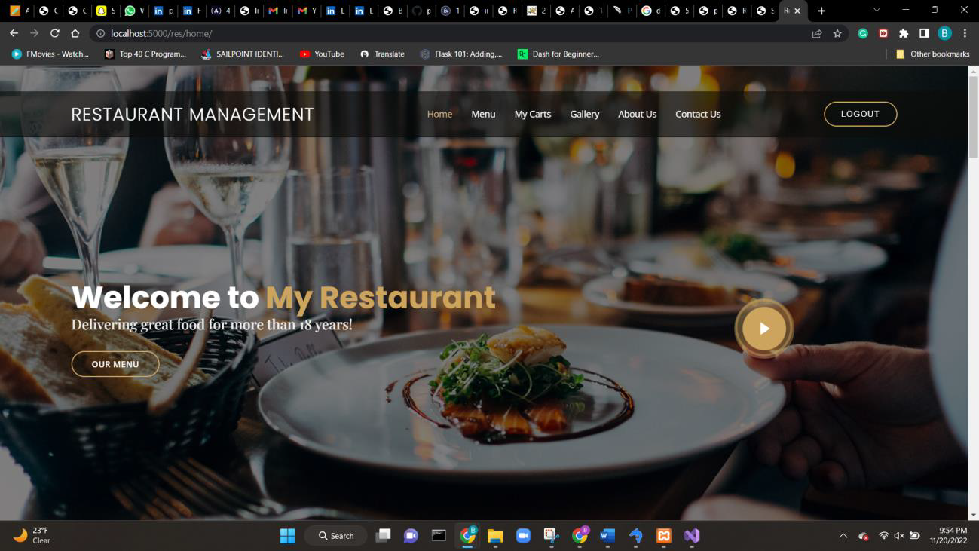
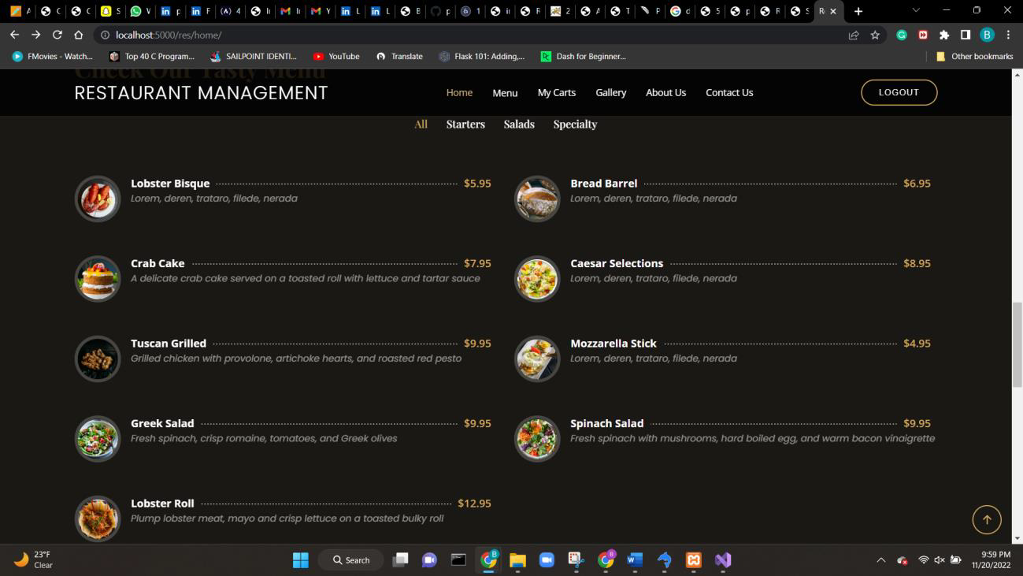
Home Page

Slide 12
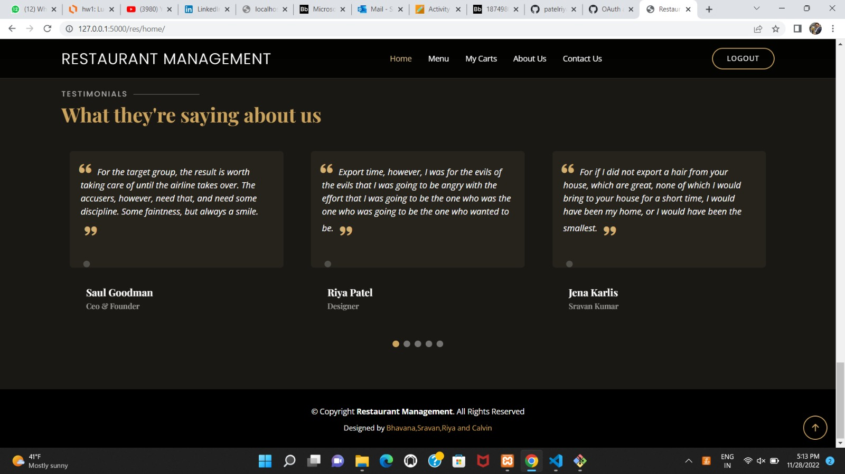
Testimonials

Slide 13
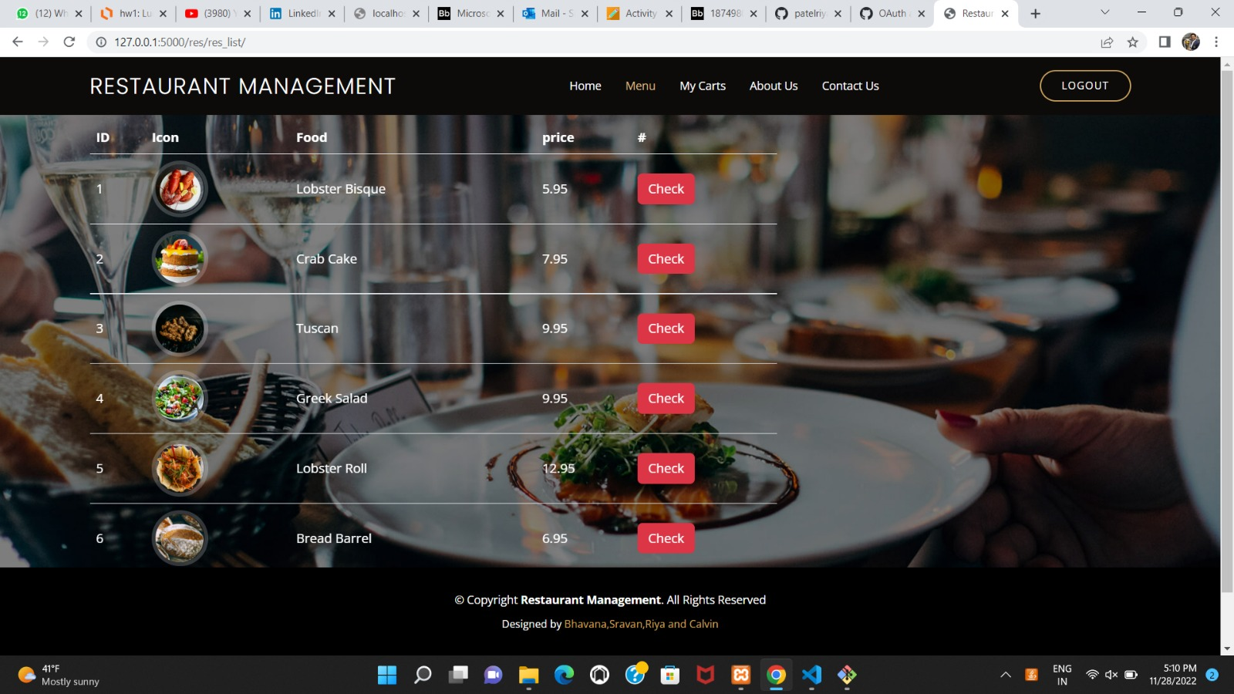
Menu Page

Slide 14
Testing
The test environment for tools is before running the python shell and compiling the app.py, we need to make sure whether the MySQL database is up and running. And then we can compile the app.py and wait for the localhost:5000 and the webpage starts running. There we can login, signup and then go deep into the website to see the Menu, testimonials and adding items to cart, etc.
Coming to Hardware we need to make sure MySQL and python are installed in the admin’s laptop and make sure the internet connection is stable.

Slide 15
Testing
Testing file

Slide 16
Thank You

